Slide 1
Track module 1 Basics of Machine Learning in Python Block 5
Ekaterina Golubeva
14.11.2022

Slide 2
Plan
Random Forest classifiers
How to use Random Forests in Python
Gabor feature banks
List of useful commands in pandas

Slide 3
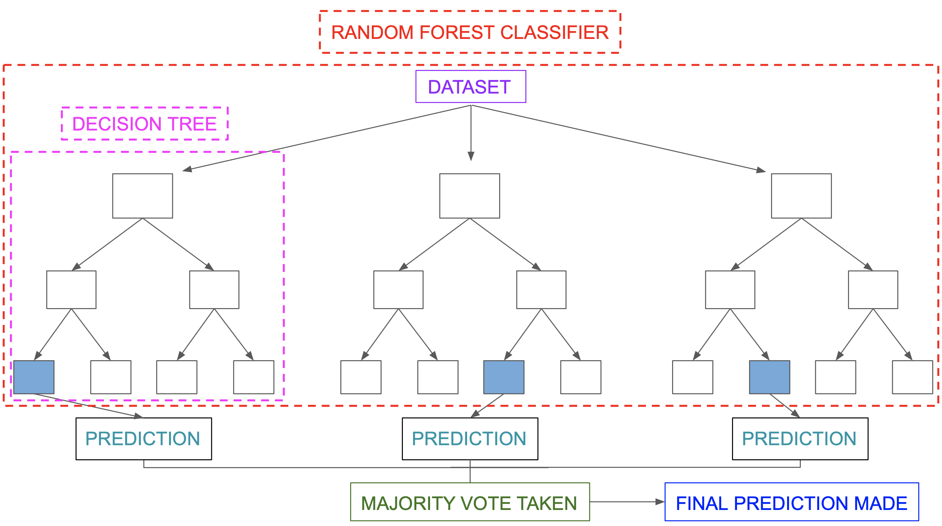
Random Forest Classifiers

Slide 4
Decision tree : example

Slide 6
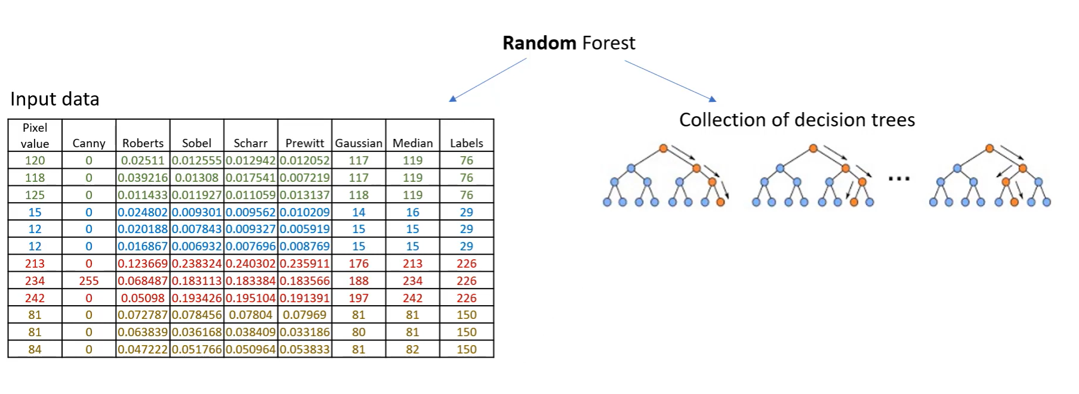
From decision trees to Random Forests

Slide 8
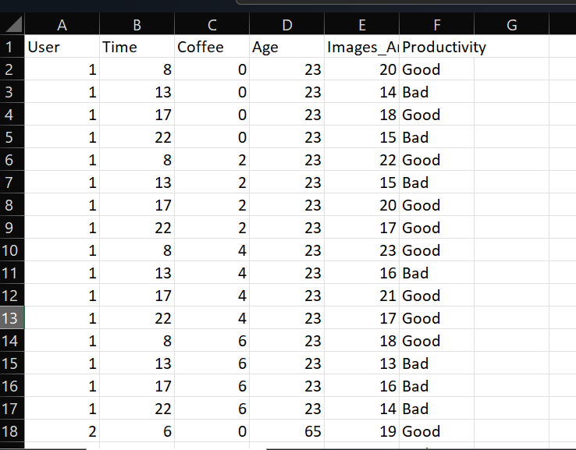
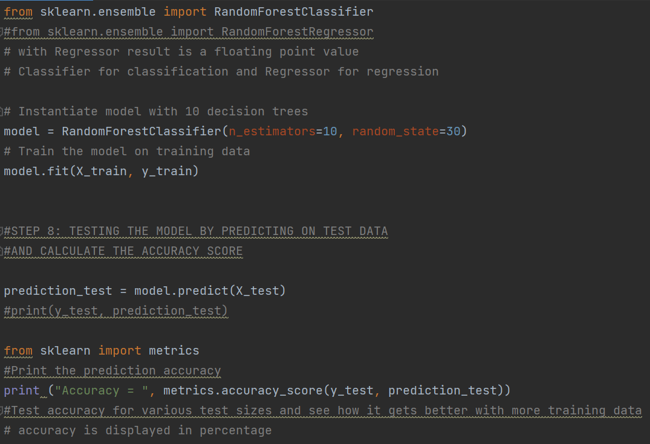
Random Forests in Python

Slide 9
Summary
Data reading and understanding
Drop irrelevant data (keep independent values)
Handle missing values, if needed
Convert non-numeric to numeric, if needed.
Prepare the data : define dependent variable we want to predict, set as integer
Split the data into train and test data.
Defining the model and training.
Testing the model by predicting on test data
Calculate the accuracy score

Slide 10
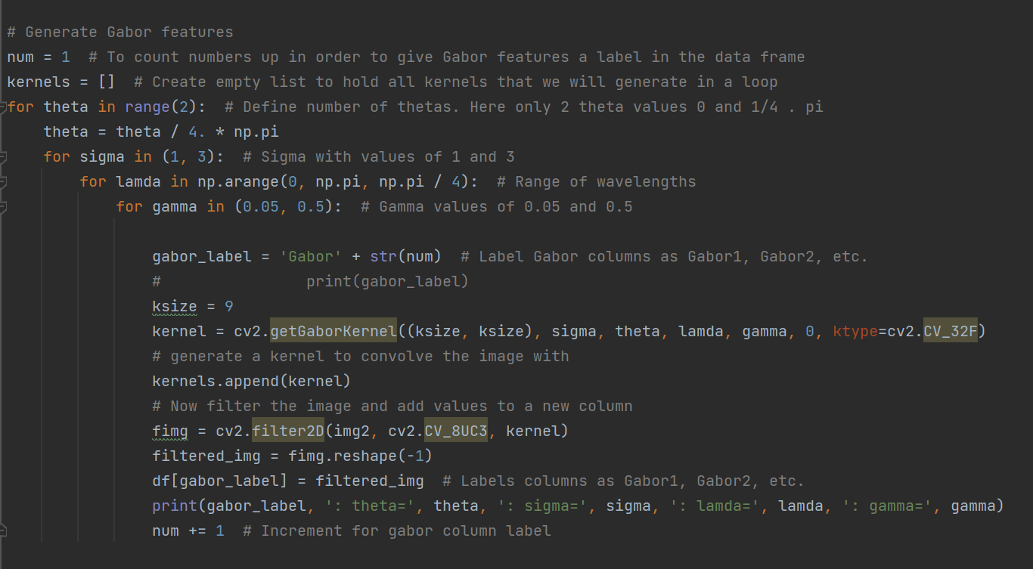

Gabor feature banks
The goal is to produce as an output a data frame with various Gabor responses from an input image that can be fed into a ML algorithm.

Slide 11
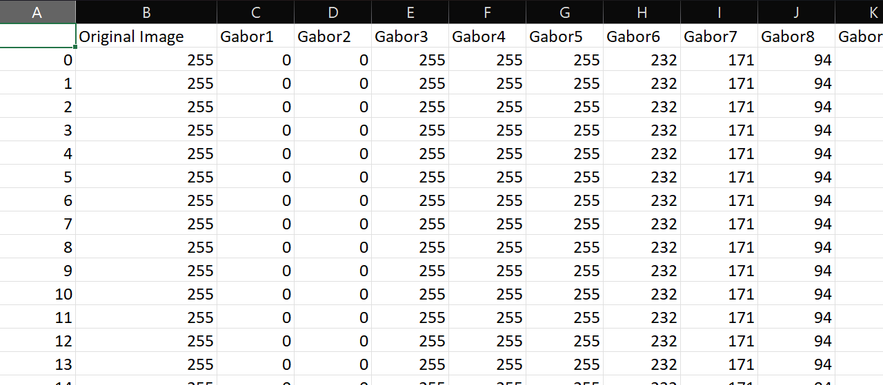
Commands used and output
Commands | Description | Library
cv2.cvtColor(img, cv2.COLOR_BGR2GRAY) | Convert to grey level | OpenCV
pd.DataFrame() | Creating an empty data frame | pandas
img.reshape(-1) | Collapsing image into a signle column
df[‚name‘] = img | Filling a column in data frame | Pandas
kernel = cv2.getGaborKernel((ksize, ksize), sigma, theta, lamda, gamma, 0, ktype=cv2.CV_32F) | Create a Gabor kernel | OpenCV
cv2.filter2D(img2, cv2.CV_8UC3, kernel) | Convolve the image with the kernel | OpenCV
df.to_csv("name.csv") | Write a csv file | pandas

Slide 12
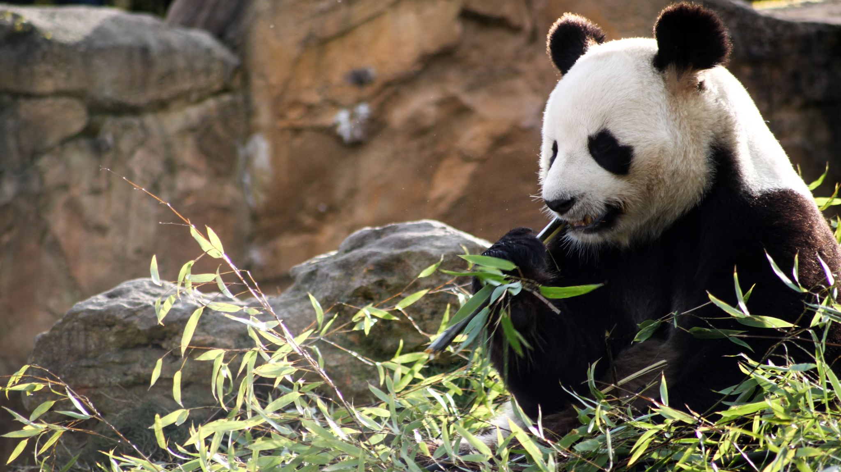
List of commands in pandas
Commands | Description
df['Area'].plot(kind='hist', title='Area', bins=50) | Draw a histogram from data frame
pd.DataFrame(data, index = [1,2,3,4], columns = ['Area', 'Intensity', 'Orientation']) | Create a data frame
print(df.info()) | Prvides an overview of the dataframe.
print(df.shape) | How many rows and columns
print(df.head()) | Default prints 5 rows from the top, First default column you see are indices.
print(df.tail()) | Default prints 5 rows from the bottom
df[‚colname‘: 0'].unique()) | To look at unique entrees
df = df.rename(columns = {'Unnamed: 0':'Image_set'}) | Rename columns
df.describe() | Gives statistical summary of each column.
df1 = df.drop("Manual2", axis=1) | Creating a new dataframe df1. Axis=1 means referring to column.
df['Date'] = pd.to_datetime("2022-11-13") | Set date as date type
df.to_csv(file_name.csv') | Write a data frame to csv
df.sort_values('Manual', ascending=True) | Sort values from lowest to highest
df[20:30] | Select specific rows

Slide 13
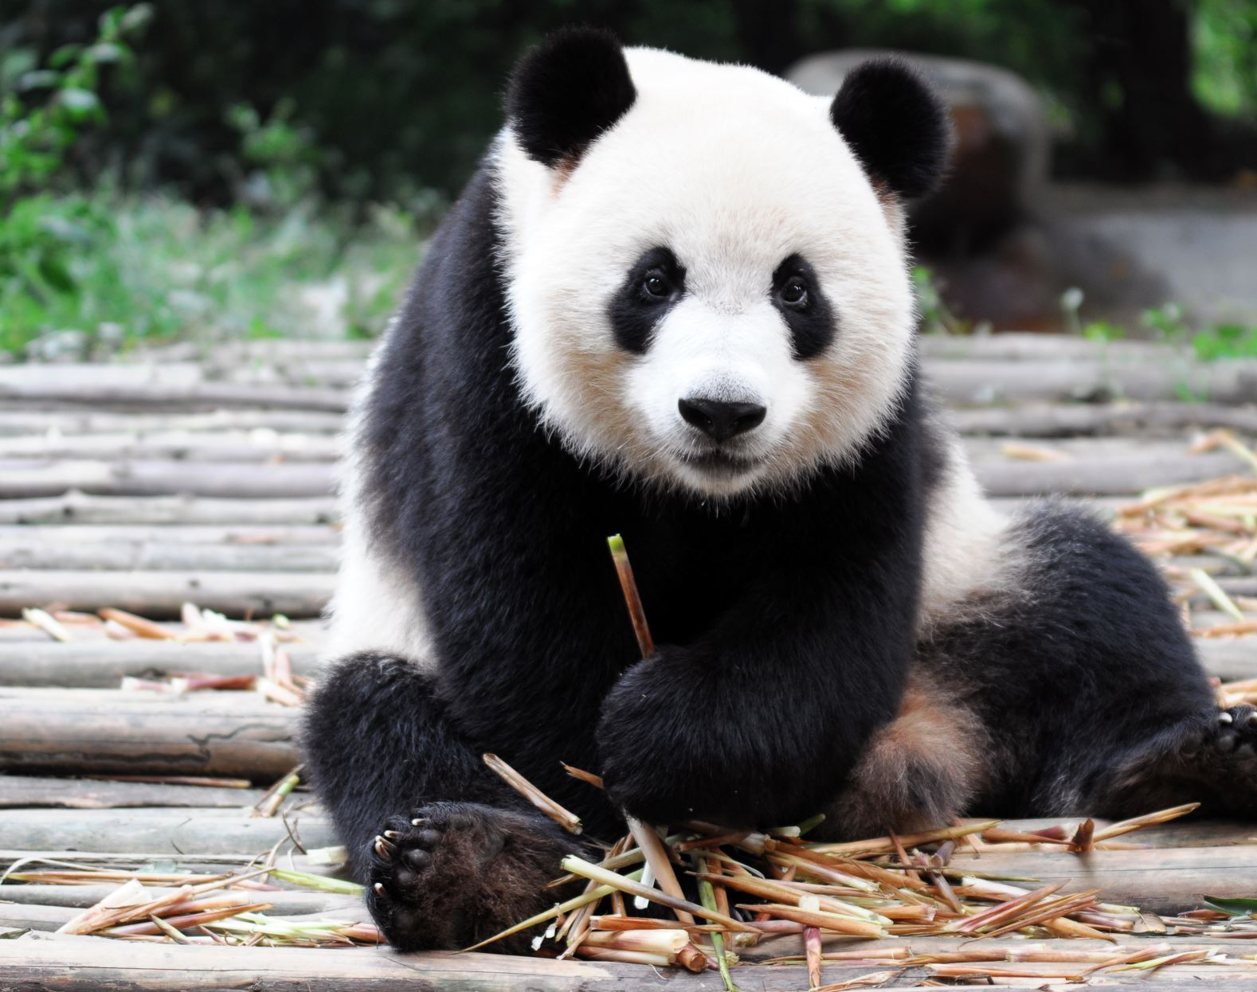
List of commands in pandas
df.loc[20:30, ['colname', 'Auto_th_2']]) | Get specific columns from specific rows
max(df[‚colname‘]) | Gives maximum value in a given column
df['colname'] > 100.) | Select values, prints True or False
df.groupby(by=[‚colname']) | Group-by’s can be used to build groups of rows based off a specific feature
df.corr() | Correlation between all columns
df.isnull()) | Shows whether a cell is null or not
df.isnull().sum() | Shows number of nulls in each column.
df.dropna() | Drops all rows with at least one null value.
print(df['colname'].describe()) | Gives statistics e.g. mean
df['colname'].fillna(100, inplace=True) | Fill na with means for example ( imputation)
df['colnamel'].plot(kind="box", figsize=(8,6)) df.boxplot(column='name_col', by='index') | Boxplot, Shows max and min values, outliers
df.plot(kind='scatter', x='x_name', y=‘y_name‘, title=‘main title‘) | Scatter plot to see relationship between columns
df["colname"].apply(function) | Apply function to the whole column

Slide 14
Further exploration
Try Gabor feature bank on my pictures
Try Random Forest on my data
Understand the choice of the root node (Gini gain)

